Slide 1
ECON 672
Week 6: Instrumental Variables
Samuel Rowe, PhD 1/5/2023

Slide 2
Overview
Takeaway
Intuition of Instrumental Variables (IV)
Two Scenarios of IV
IV with Homogenous Treatment Effects
IV with Heterogenous Treatment Effects
Examples
Popular Instruments

Slide 3
Takeaway
The instrumental variables is a powerful identification strategy that can control for unobserved confounders unlike matching strategies
We use two stages to identify the causal effect
The first stage uses a reduced form equation to estimate the treatment
The second stage estimate the estimated treatment on the outcome
Instrument Variables has advantages over fixed effects since it can handle
Simultaneity bias (reverse causality)
Omitted variable bias on unobservables confounders

Slide 4
Takeaway
Strength
Can control for unobservable confounders
It is a general identification strategy that is applicable in many scenarios
Can deal with reverse causality (simultaneity bias)
When you have a good instrument, IV is as good as random
Weakness
There are up to 5 assumptions with 3 being untestable
Weak instruments lead to bias; It is very hard to find an instrument that satisfies all 5
Residuals from IV are larger than OLS
Most of the time you will be estimating the Local Average Treatment Effects (LATE) not the ATE

Slide 5
Takeaway
Assumptions with Homogenous Treatment Effects
Exclusive restriction assumption (untestable)
Non-zero 1st stage (testable)
Assumptions with Heterogenous Treatment Effects
Exclusive restriction assumption (untestable)
Non-zero 1st stage (testable)
Independence assumption (untestable)
Stable Unit Treatment Value Assumption (SUTVA) (untestable)
Monotonicity assumption (testable)

Slide 6

Intuition of Instrumental Variables
Let’s start off with the DAG
Direct Pathway: $D→Y$
Indirect Pathway: $D←-U-→Y$
Mediated Pathway: $Z→D→Y$
$U$ is our unobserved confounder that prevents the backdoor criterion from being satisfied
People makes choices with $D$ and $U$ creates spurious correlations between $D$ and $Y$

Slide 7
Intuition of Instrumental Variables
$D$ is also a collider
$$Z→D←-U$$
The mediated pathway implies that when $Z$ varies, then $D$, which makes $Y$ vary
This is the “only through” assumption we will discuss a bit more
An exogenous shock in $Z$ may induce some people (but not all) to make a change in $D$

Slide 8
Intuition of Instrumental Variables
Two notes
$$Z⊥U$$
$Z→D$ (first-stage)
The first notation means $Z$ is independent of $U$
This is the exclusive restriction assumption
The second notation means that $Z$ impacts $D$ or $Z$ and $D$ are correlated
This is the non-zero 1st stage assumption
$Z$ is correlated with $Y$, but only through $D$

Slide 9
Good Instruments
Good instruments are hard to find
Lotteries or randomized assignment will be the best instruments
Good instruments should be based upon deep institutional knowledge
They may seem weird at an initial glance
Examples
Month of birth and labor outcomes
Distance to college in a county and labor earnings
Lotteries to offer Medicaid in Oregon
Judge fixed effects on labor outcomes
Weather at sea and quantity of whiting fish sold

Slide 10
Good Instruments
Using a prior knowledge is helpful
Draw a DAG to assess the feasibility of the instrument
You need to defend the untestable exclusive restriction assumption and you will need to do this with theory, literature, and deep institutional knowledge
There is more skepticism today about instruments than in the past due to the untestable exclusive restriction assumption
You need an instrument that works through the treatment and does not impact the outcome
For example: the gender pair of children and women labor force participation
$D$ is family size and $Z$ is gender pair and $Y$ is women’s labor force participation
$Z$ is either two girls, two boys, or one girl and one boy
$Z$ should impact $D$, but $Z$ should be irrelevant to $Y$

Slide 11
IV in Two Scenarios
Homogenous Treatment Effects
Individual treatment effects do not vary
2 assumptions
Calculate the ATE
Heterogenous Treatment Effects
Individual treatment effects vary from person to person
More assumptions
Less power due fewer observations
Calculate the LATE

Slide 12
Heterogenous and Homogenous Treatment Effects
Homogenous Treatment Effects (treatment effects do not vary)
When effects are assumed to be homogenous then our strategy is applicable to the entire population
We estimate an ATE with IV under homogenous treatment effects
Heterogenous Treatment Effects (treatment effects vary from individual to individual)
1) An exogenous shock from $Z$ may only affect a subpopulation, so our causal effect may only be valid for that subpopulation or local average treatment effects (LATE)
2) If $Z$ is only applicable to a subpopulation of compilers, there are fewer data points to identify the causal effects

Slide 13
Local Average Treatment Effects (LATE)
We are likely dealing with heterogenous treatment effects
We only identify the treatment effects to the subpopulation that responds to a change in the instrument
The local average treatment effects (LATE) is the causal effect subpopulation of compilers that compile with the instrument
IV will be underpowered since $N_{compilers}<N_{Total}$
This leads to larger standard errors

Slide 14
IV under Homogenous Treatment Effects
We’ll discuss IV under Homogenous Treatment Effects first
We assume that treatment effects are constant (or do not vary)
$$Y^{1}-Y^{0}=δ∀i$$
Under this scenario, we will be able to calculate the ATE with an IV strategy

Slide 15
IV under Homogeneous Treatment Effects

Slide 16
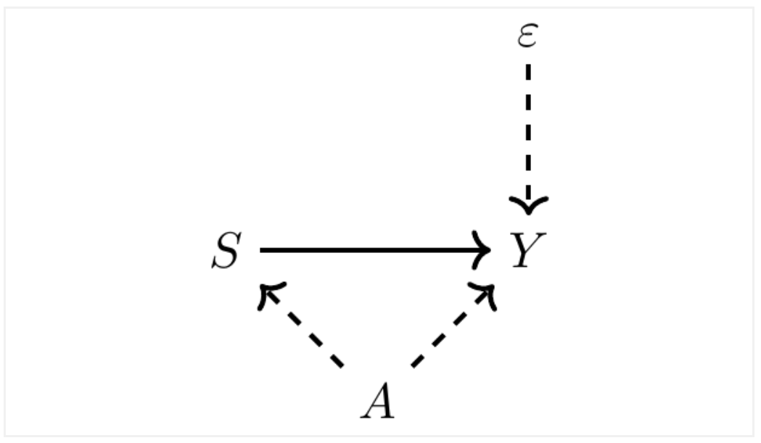
IV under Homogeneous Treatment Effects
A classic example that IV can resolve is endogeneity with schooling and ability
Ability is confounding schooling choice and earnings
Where
$Y$ is logged earnings
$S$ is schooling (treatment)
$A$ is ability
$ε$ is the error term for individual $i$

Slide 17
IV under Homogeneous Treatment Effects
Direct Pathway: $S→Y$
Indirect Pathway: $S←-A-→Y$
Ability is the unmeasured or unobserved confounder in this example
There could be other types of unobserved confounders, such as intelligence, motivation, or other non-cognitive abilities, but we use ability
The error term is uncorrelated with $S$ or $A$ in this example (which are assumptions)

Slide 18
IV under Homogeneous Treatment Effects
Given that ability is unobserved (or unmeasured) we set up the following
$$Y_{i}=α+δS_{i}+η_{i}$$
Where $η_{i}=γA_{i}+ε_{i}$
Recall
$\overset{̂}{δ}=δ+γ\frac{C(A,S)}{V(S)}$ when $A$ is omitted
Where our bias is $γ\frac{C(A,S)}{V(S)}$

Slide 19
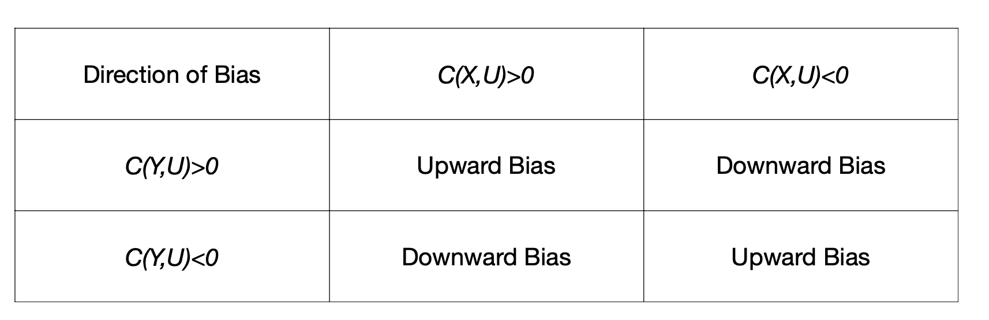
IV under Homogeneous Treatment Effects
Recall the direction of the bias
We would expect that $C(A,S)>0$ and $C(Y,A)>0$
It is likely that are $\overset{̂}{δ}$ is upward biased

Slide 20
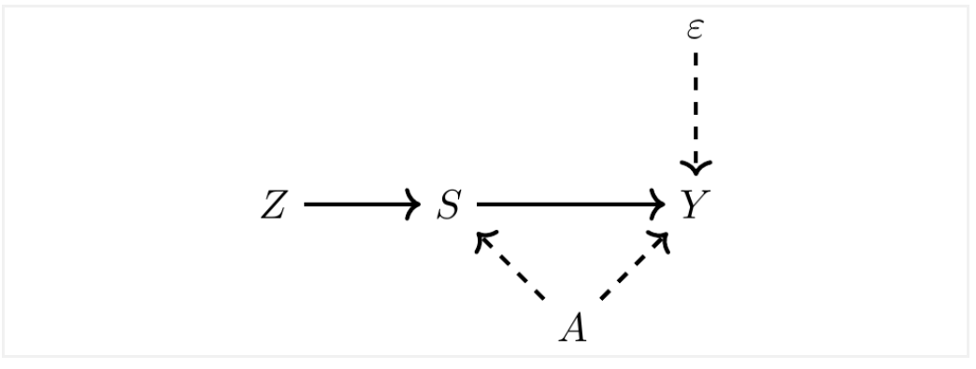
IV under Homogeneous Treatment Effects
Let’s introduce an instrument into our classic example
Assume we found a good instrument that affects $S$ but is uncorrelated with $A$ or $ε$, such as a lottery

Slide 21
IV under Homogeneous Treatment Effects
Since $Z$ is independent of our confounder $A$, we get around the endogeneity problem
There is a mediated pathway from $Z$ to $Y$, where $Z$ works through $S$ to affect $Y$
$C(Y,Z)=E[YZ]-E[Y]E[Z]$$=E[(α+δD+γA+ε)⋅Z]-E[(α+δD+γA+ε)]E[Z]$ $=E[(aZ)+(δDZ)+(γAZ)+(εZ)]-(E[α]E[Z]+E[δS]E[Z]+E[γA]E[Z]+E[ε]E[Z])$
Reorder $=\{αE[Z]-αE[Z]\}+\{δE[SZ]-δE[S]E[Z]\}+\{γE[AZ]-γE[A]E[Z]\}+\{E[ε]E[Z]-E[εZ]\}$ $=0+δ\{E[SZ]-E[S]E[Z]\}+γ\{E[AZ]-E[A]E[Z]\}+\{E[εZ]-E[ε]E[Z]\}$
Where
$$C(Y,Z)=δC(S,Z)+γC(A,Z)+C(ε,Z)$$

Slide 22
IV under Homogeneous Treatment Effects
Since $C(Y,Z)=δC(S,Z)+γC(A,Z)+C(ε,Z)$
Our parameter of interest is on the right $δ$
We can isolate the parameter of interest when
$C(A,Z)=0$ and $C(ε,Z)=0$
Then
$$\overset{̂}{δ}=\frac{C(Y,Z)}{C(S,Z)}$$

Slide 23
IV under Homogeneous Treatment Effects
This is our IV estimator
$\overset{̂}{δ}=\frac{C(Y,Z)}{C(S,Z)}$
The numerator of the IV estimator is called the reduce form
$C(Y,Z)$ or the relationship between the instrument and the outcome
The denominator of the IV estimator is called the first-stage
$C(S,Z)$ or the relationship between the instrument and our treatment

Slide 24
IV under Homogeneous Treatment Effects
We can see our two assumptions here
$\overset{̂}{δ}=\frac{C(Y,Z)}{C(S,Z)}$ when $C(A,Z)=0$ and $C(ε,Z)=0$
Exclusive restriction assumption (untestable)
$Z$ is independent of $A$ or $ε$
Non-zero 1st stage assumption
If $C(S,Z)$ is zero, then we cannot get $\overset{̂}{δ}$ since we will be dividing by 0
The stronger the correlation, the better the instrument
Key Point
If you have a weak instrument then $C(A,Z)≠0$ and $C(ε,Z)≠0$ and the estimator is biased

Slide 25
Two-Stage Least Squares
The Two-Stage Least Squares (2SLS) estimator is a common IV estimator
$${\overset{̂}{δ}}_{IV}=\frac{C(\overset{̂}{β}Z,Y)}{V(\overset{̂}{β}Z)}=\frac{C(\overset{̂}{S},Y)}{V(\overset{̂}{S)}}$$
Suppose you have data on $Y$, $S$, and $Z$
$Y_{i}=α+δS+ε_{i}$ $S_{i}=γ+βZ_{i}+ϵ_{i}$
Where $C(Z,ε)=0$ and $β≠0$
$\overset{̂}{δ}=\frac{C(Y,Z)}{C(S,Z)}=\frac{\frac{C(Z,Y)}{V(Z)}}{\frac{C(Z,S)}{V(Z)}}$ Where $\overset{̂}{β}=\frac{C(Z,S)}{V(Z)}$

Slide 26
Two-Stage Least Squares
Where $\overset{̂}{β}=\frac{C(Z,S)}{V(Z)}$, so $\overset{̂}{β}V(Z)=C(Z,S)$
$${\overset{̂}{δ}}_{IV}=\frac{C(Y,Z)}{C(S,Z)}=\frac{\overset{̂}{β}C(Z,Y)}{\overset{̂}{β}C(Z,S)}=\frac{\overset{̂}{β}C(Z,Y)}{{\overset{̂}{β}}^{2}V(Z)}=\frac{C(\overset{̂}{β}Z,Y)}{V(\overset{̂}{β}Z)}$$
Recall that $S=γ+βZ+ϵ$, so $\overset{̂}{S}=\overset{̂}{γ}+\overset{̂}{β}Z$
${\overset{̂}{δ}}_{IV}=\frac{C(\overset{̂}{β}Z,Y)}{V(\overset{̂}{β}Z)}=\frac{C(\overset{̂}{S},Y)}{V(\overset{̂}{S)}}$, Since $V(\overset{̂}{S})=V(\overset{̂}{γ}+\overset{̂}{β}Z)=V(\overset{̂}{γ})+V(\overset{̂}{β}Z)=0+V(\overset{̂}{β}Z)=V(\overset{̂}{β}Z)$ And $C(\overset{̂}{S},Y)=E[\overset{̂}{S}Y]-E[\overset{̂}{S}]E[Y]=E[Y(\overset{̂}{γ}+\overset{̂}{β}Z)]-E[(\overset{̂}{γ}+\overset{̂}{β}Z)]E[Y]$ $=E[\overset{̂}{γ}Y+\overset{̂}{β}ZY]-(E[\overset{̂}{γ}+E[\overset{̂}{β}Z])E[Y]=E[\overset{̂}{γ}Y]+E[\overset{̂}{β}ZY]-(E[\overset{̂}{γ}]E[Y]+E[\overset{̂}{β}Z]E[Y])$ $=\overset{̂}{γ}E[Y]+\overset{̂}{β}E[ZY]-\overset{̂}{γ}E[Y]-\overset{̂}{β}E[Z]E[Y]=\overset{̂}{β}E[ZY]-\overset{̂}{β}E[Z]E[Y]=\overset{̂}{β}[E[ZY]-E[Z]E[Y]]=\overset{̂}{β}C(Y,Z)$

Slide 27
Two-Stage Least Squares
$${\overset{̂}{δ}}_{IV}=\frac{C(\overset{̂}{S},Y)}{V(\overset{̂}{S})}$$
Note: the 2SLS estimator uses fitted treatment values for the second-stage estimation
The fitted treatment becomes exogenous if the assumptions hold
Caveat
There is less variation to identify the causal effect
We are only using variation from the treatment that is exogenous
A subset of the variation in treatment is being driven by variation in the instrument, which means there is less variation from this subset than the total variation
The leftover variation from the treatment is in response to the instrument

Slide 28
Good vs Weak Instruments
Angrist and Krueger (1991) provide examples with schooling on wages
A good instrument: birth month
A weak instruments: interacting birth month and year; interacting birth month and state
The authors use birth month as an instrument
Their quirk is utilizing the cutoff in birth month for entering school
These days the cutoff is in September, but back then it was December
This quirk exogenously assigns more schooling to people born before the cutoff, since students could drop out of school at 16 when compulsory schooling ended

Slide 29
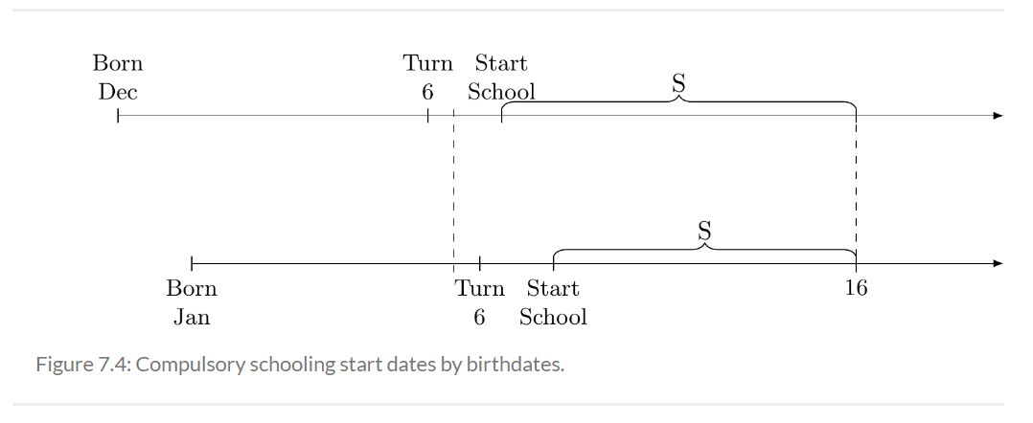
Good Instruments

Slide 30
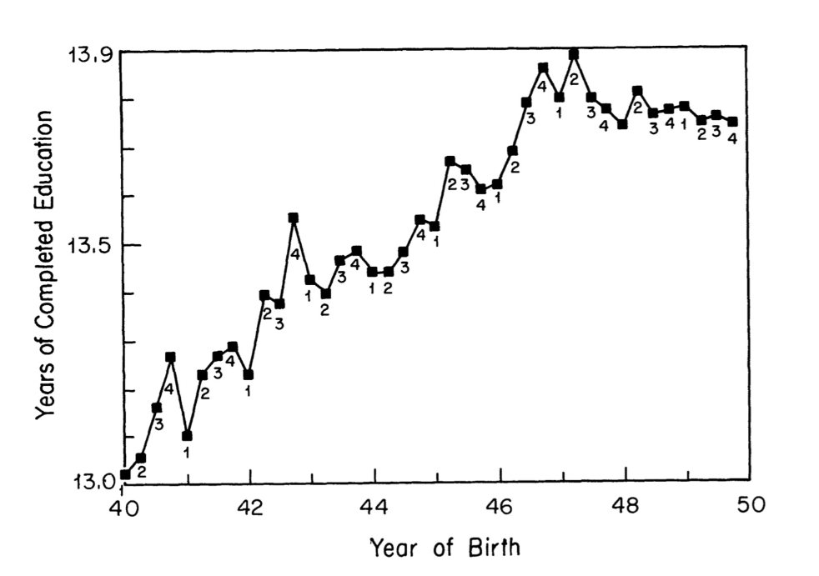
Good Instruments
The instrument increases schooling for students born in the last quarter of the year
After 1947 the schooling by quarter does flatten

Slide 31
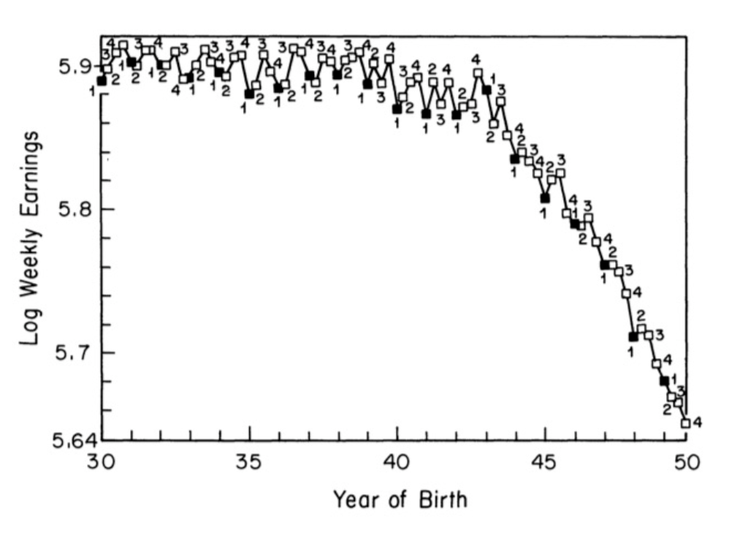
Good Instruments
The reduced form (Z on Y) shows that individuals born later in the year appear to have higher wages
The instrument seems a bit weird, but we need to defend it against other factors for the validity of the exclusive restriction assumption

Slide 32
Good Instruments
Birth month as a cutoff appears to affect $D$ and mediates $Y$
The instrument appears to be a bit weird
Why would birth month affect earnings through schooling?
Angrist and Krueger (1991) use binary variables for each quarter except the fourth quarter
$$S_{i}=Xπ_{10}+Z_{1}π_{1}+Z_{2}π_{2}+Z_{3}π_{3}+η_{1}$$
Where $Z_{i}$ is the quarter of birth and $π_{i}$ is the coefficient on each quarter

Slide 33
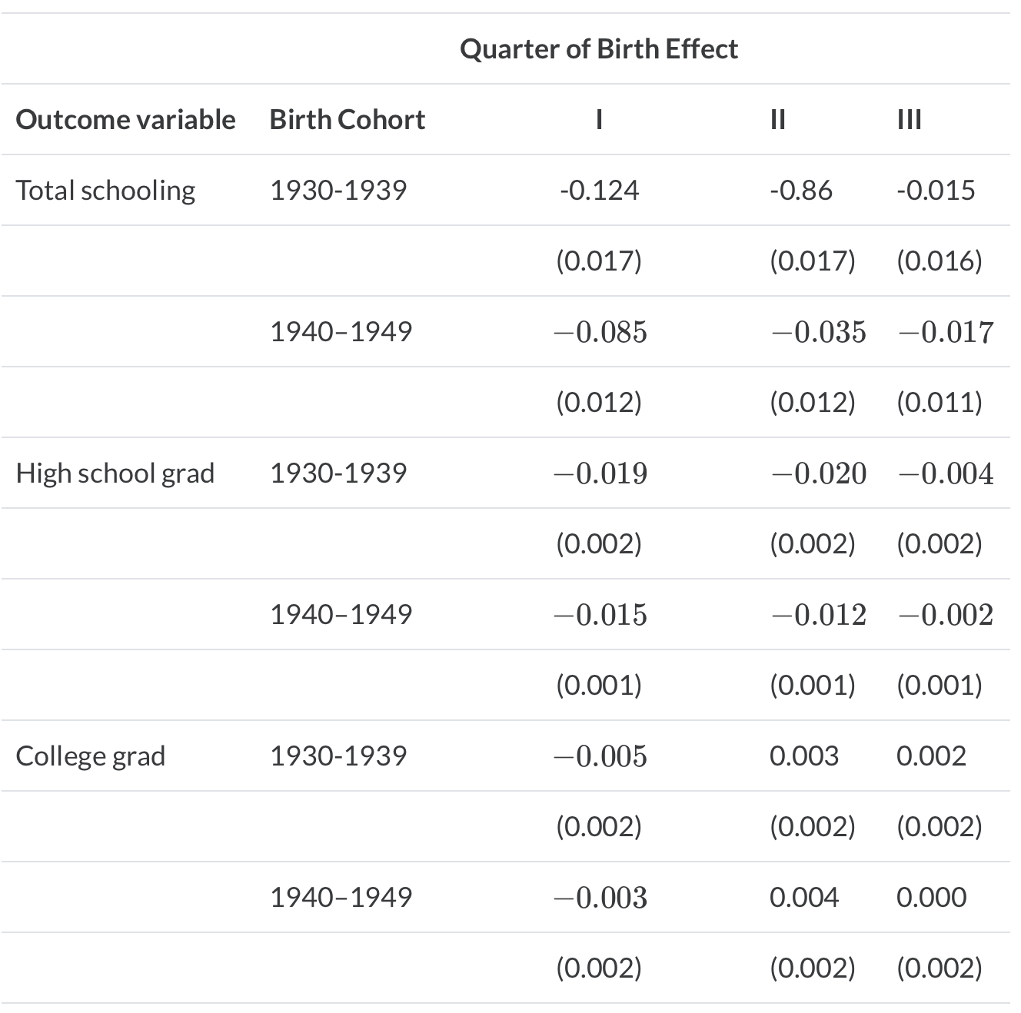
Good Instruments
Those born in the first and second quarter have less schooling
Those born in the first and second quarter are less likely to be a high school grad
College does not seem to be impacted, but compulsory laws should only affect high school
Those born in 3rd quarter do not seem different than those born in the 4th quarter

Slide 34
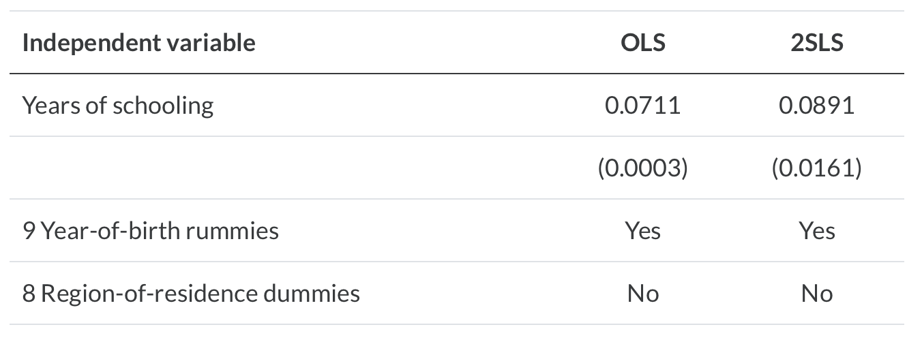
Good Instrument
In the 2nd stage, the OLS estimate of schooling is downward biased
We would expect the OLS estimate be upwards bias and give a larger estimate due to ability being positively correlated with schooling and earnings (which we will get to)
The OLS estimate shows that an additional year of schooling increases wages by 7%
The IV estimate shows that an additional year of schooling increases wages by 9%

Slide 35
Weak Instrument
Angrist and Krueger (1991) also give an example of a poor instrument
Interacting birth month and birth year dummies
Interacting birth month and state dummies
This adds a lot of unnecessary noise
We can assess this by the poor F-statistic in the first stage
Adding a poor instrument adds bias in the first-stage estimation

Slide 36
Weak Instrument
Estimating the 1st stage with a weak instrument introduces bias
Our causal model of interest (schooling on earnings)
$y=α+βs+ε$, where $s$ is an endogenous regressor
Our 1st stage with instrument $Z$ will be
$$s=πZ+η$$
We will assume that $ε$ and $η$ are correlated, then the first-stage estimate by OLS is biased
$$E[{\overset{̂}{β}}_{OLS}-β]=\frac{C(ε,η)}{V(η)}$$

Slide 37
Weak Instrument
Rename $\frac{C(ε,η)}{V(η)}$ as $\frac{σ_{εη}}{σ_{η}^{2}}$
Jaeger and Baker (1995) show that the bias of the 2SLS centers on the previously defined OLS bias grows as the weakness of the instrument grows
Angrist and Pischke (2009) shows bias as a function of the 1st stage F statistic
$$E[{\overset{̂}{β}}_{2SLS}-β]≈\frac{σ_{εη}}{σ_{η}^{2}}⋅\frac{1}{F+1}$$

Slide 38
Weak Instrument
$$E[{\overset{̂}{β}}_{2SLS}-β]≈\frac{σ_{εη}}{σ_{η}^{2}}⋅\frac{1}{F+1}$$
The $F$ statistic is a joint significance of the instruments in the 1st stage
If the 1st stage is instrument is weak then $F→0$ and $E[{\overset{̂}{β}}_{2SLS}-β]≈\frac{σ_{εη}}{σ_{η}^{2}}$
If the 1st stage is instrument is strong then $F→∞$ and $E[{\overset{̂}{β}}_{2SLS}-β]≈0$
When we have a strong instrument our bias approaches 0

Slide 39
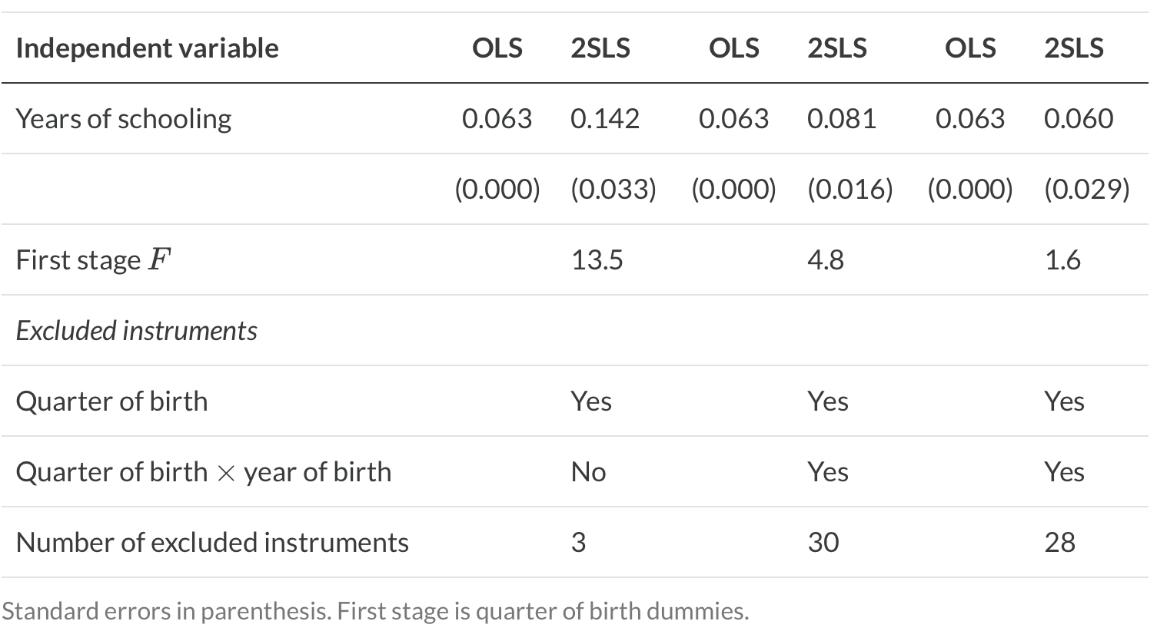
Weak Instruments
As $F$ increases the bias is reduced
Our best instrument only contains birth months
When including year-month interactions $F$ approaches 0

Slide 40
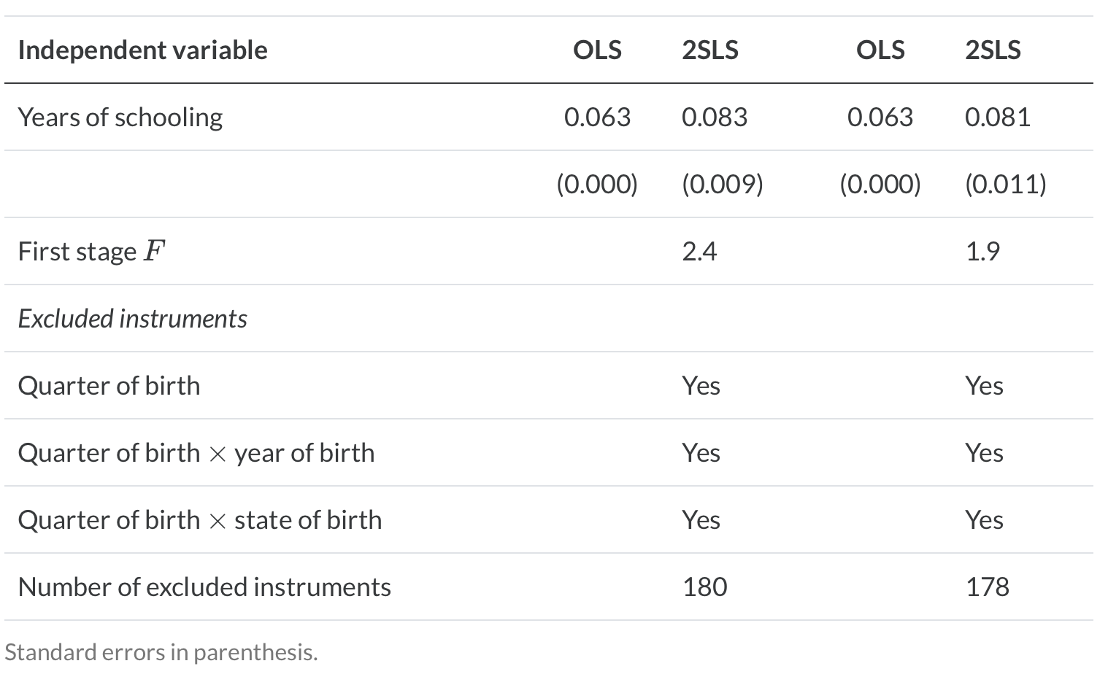
Weak Instruments
When including state & birth month interactions $F→0$
When including all interactions $F→0$
Our best instrument schooling increases wages by 14.2 percent

Slide 41
Concluding Remarks for Weak Instruments
The rule of thumb for a good instrument: $F>15$
What to do when you have a weak instrument
Not much you can do
1st - use a just-identified model with your strongest IV
2nd - use a limited information maximum likelihood estimator (LIML)
May not help much
3rd - get a better instrument
Easier to say than do

Slide 42
IV with Heterogenous Treatment Effects

Slide 43
IV with Heterogenous Treatment Effects
IV can be a powerful tool in your estimator toolbox
However, it does have additional assumptions if your treatment effects are heterogenous instead of homogenous
It is more likely that you will have heterogenous treatment effects
If individual treatment effects do vary from person to person we will need additional assumptions
If we have heterogenous treatment effects
$$Y_{i}^{1}-Y_{i}^{0}=δ_{i}$$

Slide 44
IV with Heterogenous Treatment Effects
Main Question
What is the IV estimator estimating in the presence of heterogenous treatment effects?
Under homogenous treatment effects
Treatment effects do not vary and we can generalize the results to everyone in the population
When we have internal validity with our causal estimate, we also have external validity
Under heterogenous treatment effects
We can no longer generalize the results to the population of interest
Even with an internally valid causal estimate, we lack external validity (generalizability)

Slide 45
IV with Heterogenous Treatment Effects
Angrist (1990) utilizes a help example for understanding IV with heterogenous treatment effects
He assessed the impact of schooling on wages and utilizes the military draft lottery as an IV
He estimates the returns to military service from the draft lottery number
Complying with the instrument
If you get selected, you go into military service
$Z=1$ then $D=1$
If you don’t get selected, you don’t go into military service
$Z=0$ then $D=0$

Slide 46
IV with Heterogenous Treatment Effects
Under heterogenous treatment effects we have a new potential variable in our potential outcome notation
$Y$ depends on two variables $D$ and $Z$, such as $Y_{i}(D_{i},Z_{i})$
Observed treatment status is our new variable
$D_{i}^{1}$ treatment status when $Z_{i}=1$
$D_{i}^{0}$ treatment status when $Z_{i}=0$

Slide 47
IV with Heterogenous Treatment Effects
Observed treatment status is based upon a switching equation
$$D_{i}=D_{i}^{0}+(D_{i}^{1}-D_{i}^{0})Z_{i}$$
$$D_{i}=π_{0}+π_{1}Z_{i}+ϕ_{i}$$
Where
$$π_{0}=E[D_{i}^{0}]$$
$$π_{1}=(D_{i}^{1}-D_{i}^{0})$$
$E[π_{1}]$ is the average causal effect of $Z_{i}$ on $D_{i}$

Slide 48
Assumptions under Heterogenous Treatment Effects
There are 5 assumptions when heterogenous treatment effects occur
1) Stable Unit Treatment Value Assumption (untestable)
2) Independence Assumption (untestable)
3) Exclusion Restriction Assumption (untestable)
4) Non-Zero 1st Stage Assumption (testable)
5) Monotonicity Assumption (testable)

Slide 49
Assumptions under Heterogenous Treatment Effects
Stable Unit Treatment Value Assumption (not testable)
There are no spillovers for treatment status
Using Angrist (1990) example, no one’s draft lottery numbers should affect anyone else
Independence Assumption (not testable)
It states that the instrument is independent of potential outcomes and potential treatment assignment
This assumption here basically states that the instrument is good as random
$$\{Y_{i}(D_{i}^{1},1),Y_{i}(D_{i}^{0},0),D_{i}^{1},D_{i}^{0}\}⊥Z_{i}$$
Using Angrist (1990) example, lottery numbers are independent of potential earnings or potential military service

Slide 50
Assumptions under Heterogenous Treatment Effects
Independence Assumption (cont).
Reduced Form under Independence Assumption
$E[Y_{i}|Z_{i}=1]-E[Y_{i}|Z_{i}=0]=E[Y_{i}(D_{i}^{1},1)|Z_{i}=1]-E[Y_{i}(D_{i}^{0},0)|Z_{i}=0]$ $=E[Y_{i}(D_{i}^{1},1)]-E[Y_{i}(D_{i}^{0},0)]$
Only if were interested in studying the instrument on the outcome
1st stage under the Independence Assumption
$E[D_{i}|Z_{i}=1]-E[D_{i}|Z_{i}=0]=E[D_{i}^{1}|Z_{i}=1]-E[D_{i}^{0}|Z_{i}=0]$ $=E[D_{i}^{1}-D_{i}^{0}]$
This part is more of an interest, since we are concerned about the endogenous treatment

Slide 51
Assumptions under Heterogenous Treatment Effects
Exclusion Restriction Assumption (untestable)
The effect of $Z$ on $Y$ must go through the effect of $Z$ on $D$
$Y_{i}(D_{i},Z_{i})$ is a function of $D_{i}$ only
Using Angrist (1990) example, if low lottery numbers were associated with people avoiding the draft then it would be a violation on an unobserved confounder
Non-zero 1st Stage Assumption (testable)
$Z$ must be correlated with $D$, our endogenous treatment variable of interest
$$E[D_{i}^{1}-D_{i}^{0}]≠0$$
Remember that is there is no correlation between $Z$ on $D$, then the denominator of our estimator is zero and is unable to be estimated
Using Angrist (1990) example, if the lottery increase the probability of military service, then it is correlated

Slide 52
Assumptions under Heterogenous Treatment Effects
Monotonicity Assumption
This assumption states that the instrument works in the same direction for everyone
The instrument is either negative or positive for treatment assignment, but not both
Either $π_{1}>0∀i=1,...,N$ or $π_{1}<0∀i=1,...,N$
Seems strange at first, but it is intuitive
Using Angrist (1990) example, a military draft lottery will push people into service or out of service, but not both

Slide 53
Local Average Treatment Effect (LATE)
When all 5 assumptions are satisfied
The IV estimator identifies the causal effect for compilers
This means we do not identify the ATE
We identify the causal effect of a subpopulation of compilers to the instrument
Also known as the Local Average Treatment Effect (LATE)
$$δ_{IV,LATE}=\frac{EffectofZonY}{EffectofZonD}=\frac{E[Y_{i}(D_{i}^{1},1)-Y_{i}(D^{0},i,0)]}{E[D_{i}^{1}-D_{i}^{0}]}$$
$=E[Y_{i}^{1}-Y_{i}^{0}|D_{i}^{1}-D_{i}^{0}=1]$

Slide 54
Subpopulations of IV
We have 4 subpopulations with our LATE IV estimator
Compliers
These are our group of interest - they compile with the instrument
$$(D_{i}^{1}-D_{i}^{0})=(1-0)=1$$
Using the Angrist (1990), they get drafted and compile with the draft into military service
Defiers
This subpopulation is a bit odd, and do the exact opposite of the instrument
$$(D_{i}^{1}-D_{i}^{0})=(0-1)=-1$$
Using the Angrist (1990), they get drafted and avoid military service, or they don’t get drafted and enlist in the military

Slide 55
Subpopulations of IV
Never Takers
This subpopulation never takes the treatment regardless of the instrument
$$(D_{i}^{1}-D_{i}^{0})=(0-0)=0$$
Using Angrist (1990), they get drafted and compile with the draft into military service
Always Takers
This subpopulation always takes the treatment regardless of the instrument
$$(D_{i}^{1}-D_{i}^{0})=(1-1)=0$$
Using Angrist (1990), this subpopulation always enlist regardless of the lottery outcome

Slide 56
IV and Subpopulations
Key Point
The IV only identifies the causal effect for the compiler subpopulation
The causal effect cannot be generalized to the other 3 subpopulations
The LATE is the local causal effect of the IV estimator on compliers

Slide 57
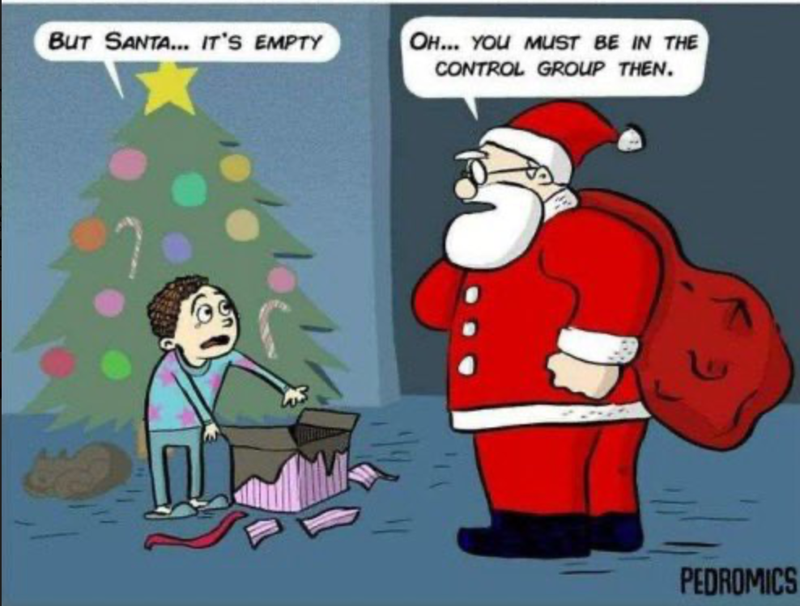
Good Instruments (move to later)
A lottery can be a very good instrument

Slide 58
Applications
College impact on earnings
County in a College as an IV
Fulton Fish Market
Price and quantity are endogenous
Weather at Seas as an IV

Slide 59
College in County IV
Card (1995) is interesting in estimating the returns to schooling or the impact of college on earnings
The endogenous model should be familiar
$$Y_{i}=α+δS_{i}+γX_{i}+ε_{i}$$
Card (1995) uses data from the Young Men Cohort from the National Longitudinal Survey in 1966 with 5,525 aged 14-24
Followed up until 1981
One of the data elements was if the individual lived in a county with a 2-year or 4-year college

Slide 60
College in County IV
Problem
We know that ability is an unobserved confounder correlated with schooling and earnings, such that $C(S,ε)≠0$
Card (1995) proposes using a college within a county, $Z$, of residence as an instrument on going to college, $D$
College in county will be the dummy variable instrument
Does this instrument satisfy all 5 assumptions?
Stata Exercise

Slide 61
College in County IV
Our four subpopulations
Compliers
They comply with the instrument and go to college
This is the subpopulation of interest - their marginal cost of attending college is reduced due to the proximity, such that they could live with their parents
We will calculate the LATE for this subpopulation
Defiers
They defy the instrument and don’t go to college if one is in the county
Never Takers
They never intent to go to college regardless of the presence of a college in the county
Always Takers
They will always intent to go to college regardless of the presence of a college in the county

Slide 62
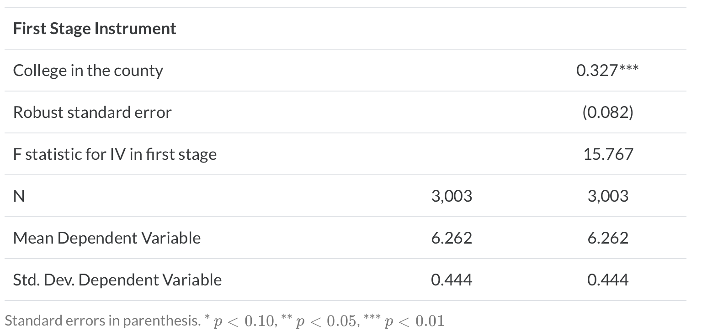
College in County IV
Using -ivregress 2sls- in Stata shows us our 1st stage result
Going to college in a county results in an increase of schooling by 0.327 years

Slide 63
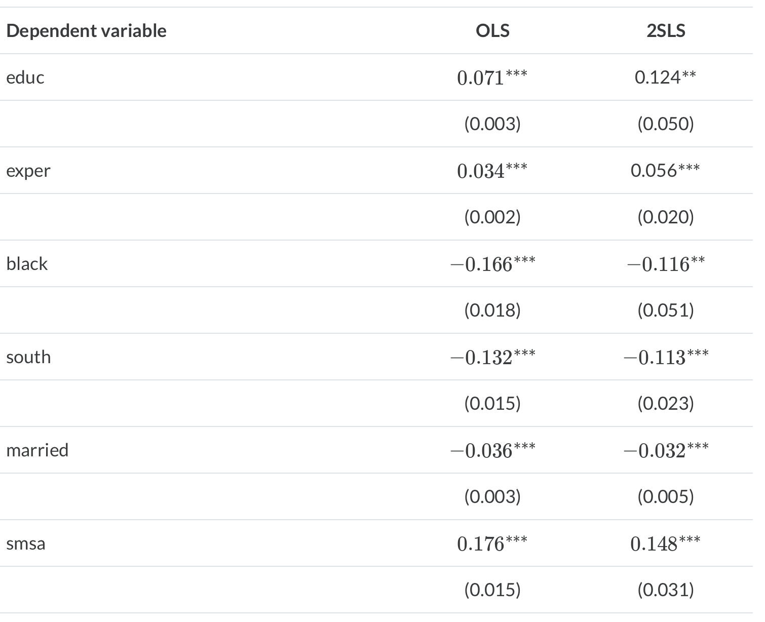
College in County IV
Our OLS estimate is downward bias
Going to college increases earnings for compliers by about 13.2%
Remember that our model is log-linear
$$e^{0.124}-1*100\%$$

Slide 64
College in County
The LATE estimate is higher than the biased OLS estimate
0.071 compared to 0.124 (or 7.4% compared to 13.2%)
We would expect that our OLS estimate to be upward biased not downward biased
Why did this happen?
1) We could have measure error, e.g.: inaccurately measure years of schooling
2) It is possible that compliers have higher returns to schooling and the lower marginal costs of attending schooling are shifting compliers into more schooling

Slide 65
Fulton Fish Market - Sea Weather IV
Graddy (2006) wants to estimate the price elasticity of demand for fish at the Fulton Fish Market
$$ln(Q_{i})=α+δln(P_{i})+γX_{i}+ε_{i}$$
Graddy focus on natural log of whiting fish sold ($Q$), the natural log of average daily price of whiting fish ($P$), day of week dummies and time trend for ($X$)
The Problem
Price and quantity are determined simultaneously:
We observe only a pair of quantity and price (not the demand curve)
The demand curve can be seen as a sequence of potential outcomes (quantity) and potential treatment (price)
The demand curve is a real object but mostly unobserved

Slide 66
Fulton Fish Market - Sea Weather IV
Graddy (2006) proposes two instruments using weather at sea days before arriving at the market
The first instrument is the average maximum wave height in the prior 2 days before arriving at the market
The second instrument is a 3-day lag in wind speed
The wave instrument has a strong F-statistic greater than 22, while the wind instrument has a weaker F-statistic less than 7
What are the instruments doing?
Does it make it harder to fish?
Does it change the composition of fish? If so, then it violates the exclusion restriction assumption, since it directly affects quantity sold instead of through price

Slide 67
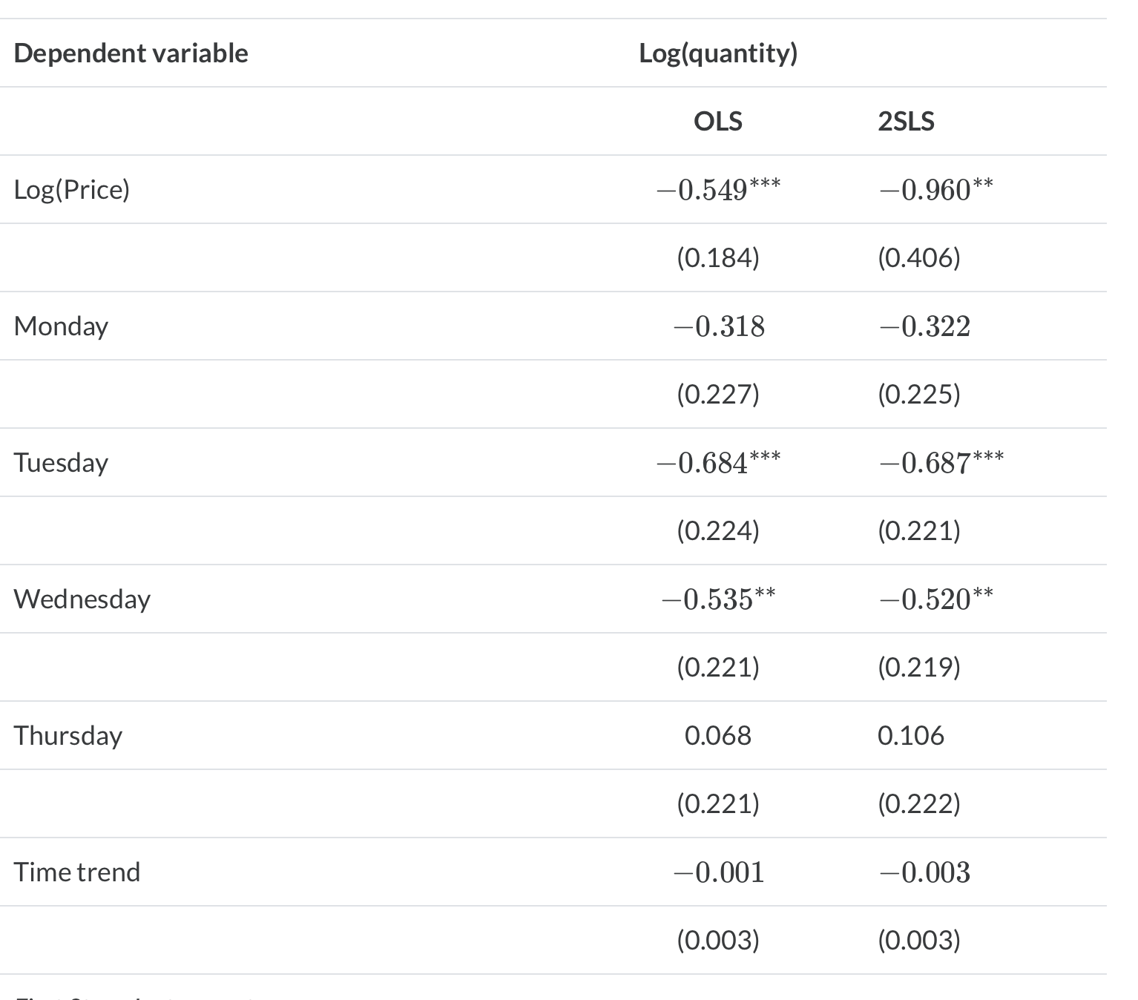
Fulton Fish Market - Sea Weather IV
With average wave height price elasticity is almost unitary elastic, while the biased OLS estimate shows inelastic price elasticity

Slide 68
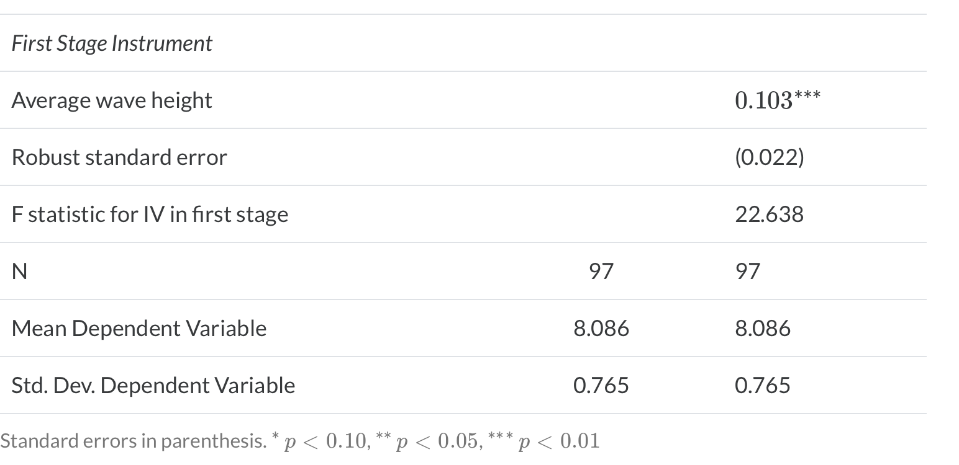
Fulton Fish Market - Sea Weather IV
The F-statistic for wave height is 22.638 and above our rule of thumb of 15
A 1 unit increase in wave height increases prices by 10.8%

Slide 69
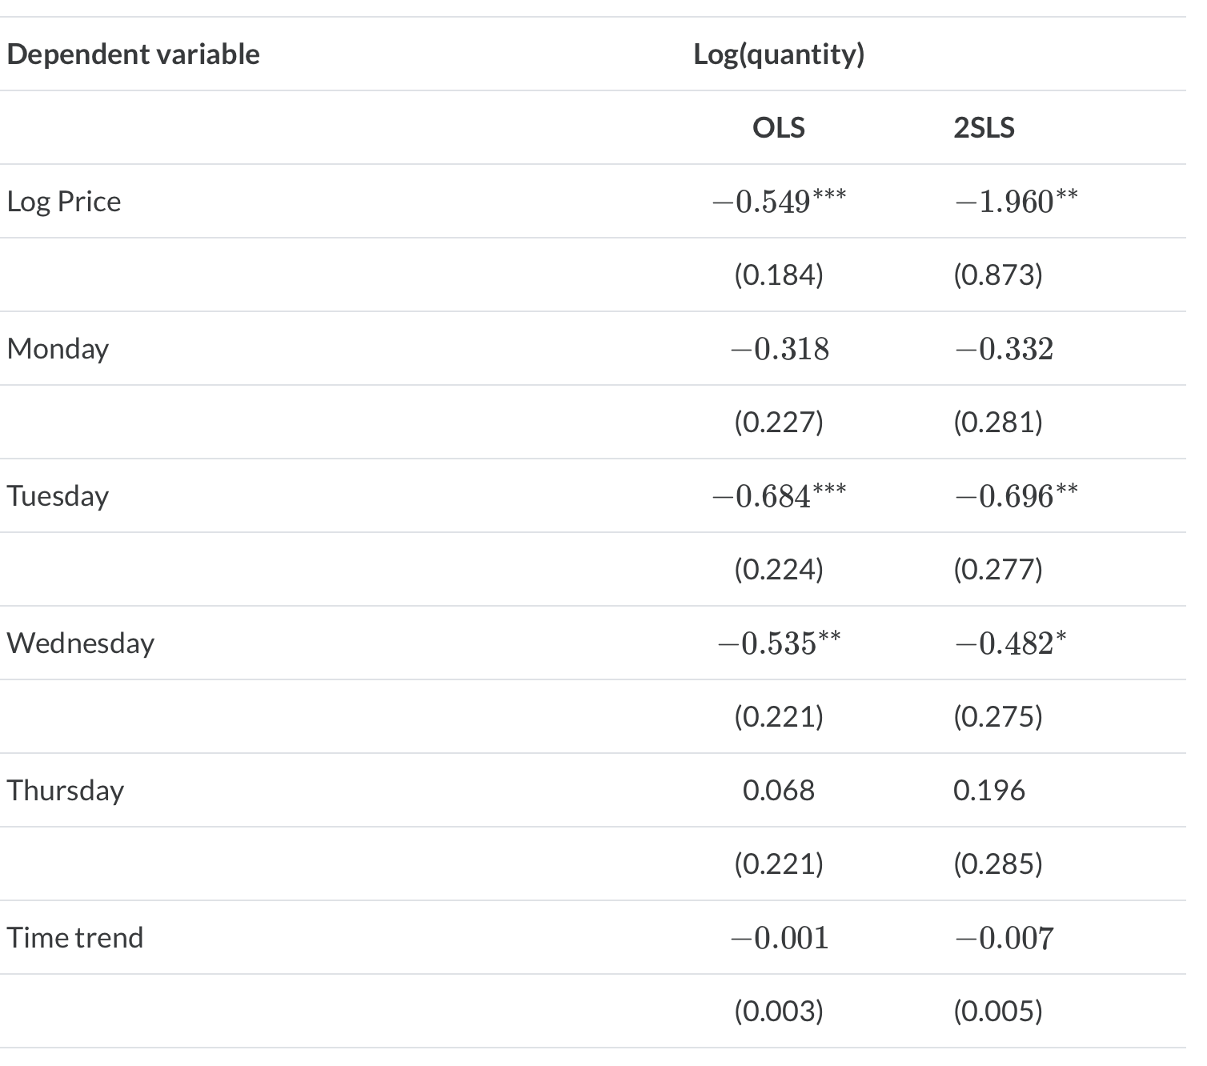
Fulton Fish Market - Sea Weather IV
With the weaker instrument our price elasticity of demand is highly elastic
But it might be biased due to the weaker instrument
At best, it is only relevant to the subpopulation of compliers

Slide 70
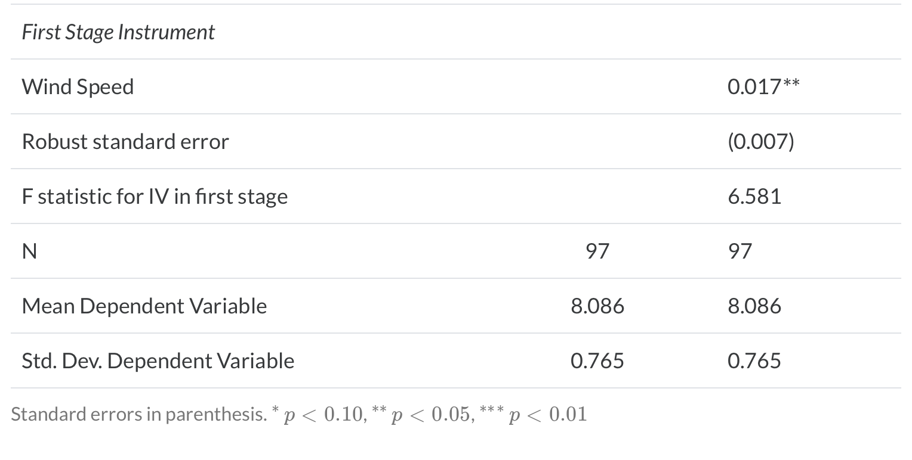
Fulton Fish Market - Sea Weather IV
Our F-statistic is less than 7 with lagged wind speed
Our elastic estimate might be biased through assumption violations

Slide 71
Popular IV Designs
The IV estimator is a good general identification strategy
The key is getting a good instrument
We will cover 2 popular IV designs
Lotteries
Judge Fixed Effects

Slide 72
Lotteries
Randomized lotteries are a popular instrument to utilize in an IV strategy
Pros
Good source of exogenous variation
Can be good as random and uphold our assumptions
Cons
May not always be available
Only recover the LATE for individuals who self-select into the lottery and comply with the lottery
Oregon Medicaid Lottery Study
Finkelstein, et al. (2012) and Baicker, et al. (2013) assessed the impact of the Medicaid lottery for a broad range of outcomes
Financial outcomes, health-care utilization outcomes, and health outcomes

Slide 73
Lotteries
Research Question:
What are the effects of expanding access to public health insurance for low income workers?
Observational studies are confounded by self-selection in health insurance
Oregon Medicaid Expansion - Oregon Medicaid Experiment
Expanded Medicaid by offering a lottery to enroll in Oregon Health Standard Plan
In 2008, 30,000 out of 85,000 were selected to be offered the plan
Out of the 30,000 offered to enroll, only 10,000 people actually enrolled
Generalizability
It is important to remember that people sort into lotteries, such as for Medicaid in Oregon, charter schools, etc.
We will lack generalizability on the general population

Slide 74
Lotteries
LATE Empirical Framework
1st Stage: $I_{ihj}=π_{0}+π_{1}L_{h}+π_{2}X_{ih}+π_{3}V_{ih}+ε_{ihj}$
2nd Stage: $y_{ihj}=α+δ{\overset{̂}{I}}_{ih}+βX_{ih}+γV_{ih}+ϵ_{ihj}$
Where $i$ is an individual, $h$ is household, and $j$ is a domain of health outcomes
$y_{ihj}$ are health outcomes of interest
$L_{h}$ is the instrument - if the household wins the lottery
$I_{ih}$ is the treatment of interest - Medicaid
$X_{ih}$ is a set of covariates related to having Medicaid and health outcomes (observable confounders)
$V_{ih}$ is a second set of covariates

Slide 75
Lotteries
Intent-to-Treat (ITT)
The ITT is the impact of offering the treatment
Offering the treatment whether or not the individual observation takes the treatment
The ITT includes non-compliance
It will be an unbiased estimate, but watered down due to non-compliance
Baicker, et al. (2013) use the reduced form to estimate the ITT
Empirical Framework: $y_{ihj}=β_{0}+β_{1}L_{h}+β_{2}X_{ih}+β_{3}+ε_{ihj}$

Slide 76
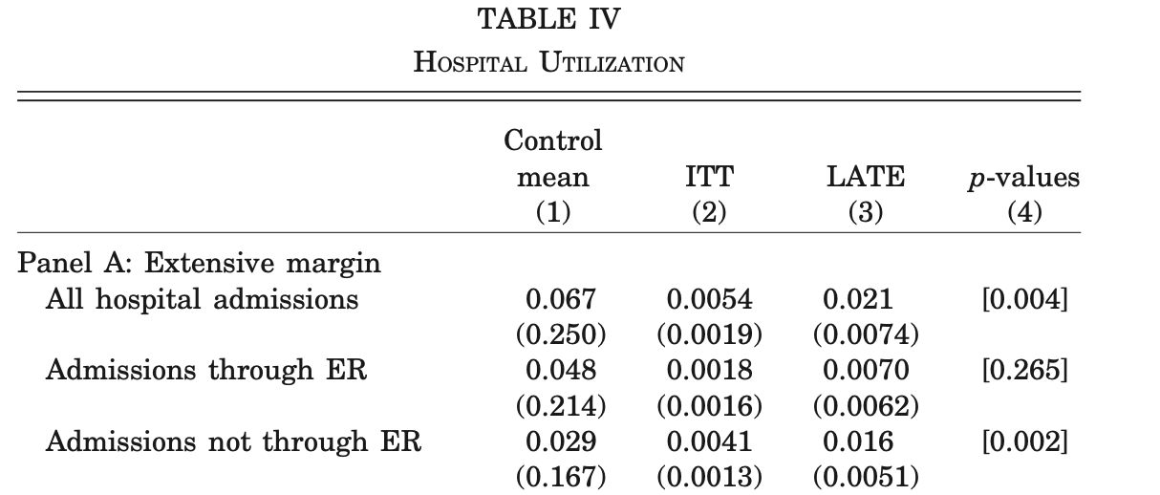
Lotteries
ITT vs LATE
Having Medicaid increases hospital admissions, but does not increase ER utilization
Having Medicaid increased usage of non-ER services that reduces ER strain
The ITT is less than the LATE since it includes everyone who one the lottery

Slide 77
Judge Fixed Effects
Intuition
When judges are randomly assigned to cases, we have a source of exogeneity
For example, Harris County, TX uses a bingo machine to assign justice-involved individuals to one of 12 courts
3 Notes with this design
There is a narrow pipeline that all justice-involved individuals must pass through
Randomized assignment to judges (decision-makers)
Discretion among the judges

Slide 78
Judge Fixed Effects
Pros
A source of exogeneity when randomized assignment is used
Cons
Independence Assumption of the instrument, Exclusion Restriction, and Monotonicity assumptions have a higher likelihood of being violated
Monotonicity is especially salient here
Judges must be consistent or else the instrument is not in the same direction

Slide 79
Judge Fixed Effects
Concerns
Independence assumption might be violated in the face of randomized assignment
If the defendant responses to the instruments (such as reputation of the judge) after assignment and changes plea for a delay or different judge
We can test covariate balance with the judge on observed but not unobserved covariates
Exclusion restriction assumption should be examined
A defendant may accept a lesser plea bargain due to judge’s anticipated severity
This mean that the instrument does not work through treatment

Slide 80
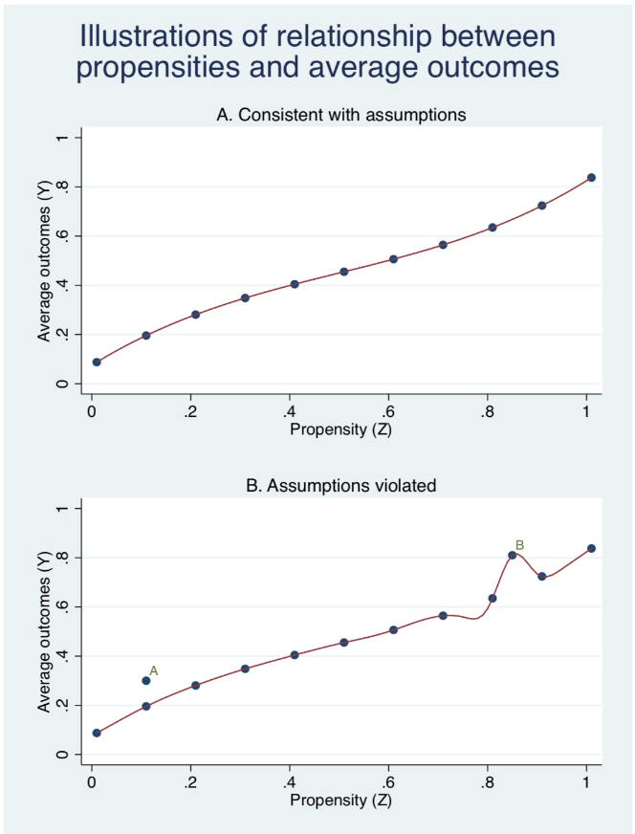
Judge Fixed Effects
Concerns
Monotonicity assumption should concern you with judge fixed effects
Either the judge is lenient or strict, but not both
The judge needs to be consistent
Frandsen et al. (2019) proposes a test for monotonicity

Slide 81
Judge Fixed Effects
Example Stevenson (2018)
Stevenson (2018) looks into how cash bail affects case outcomes
Question: Does pre-trail detention increase guilty pleas?
She utilizes admin data from Philadelphia for random assignment to bail judges, who vary at the propensity to set affordable bail
More strict bail judges set bail very high, so defendants remain in detention before trial
Data
She looks at 332,971 observations for 8 randomly assigned judges
Stevenson (2018) utilizes a jackknife instrumental variable estimator (JIVE)
This is common with judge fixed effects

Slide 82
Judge Fixed Effects
IV vs JIVE
Jackknife Instrumental Variable Estimator (JIVE)
Proposed by Angrist, Imbens, and Krueger (1999) to deal with finite-bias in 2SLS from weak instruments
JIVE is a “leave one out” estimator, such that all observations except the $i^{th}$
It assess the mean strictness of a judge in all other cases

Slide 83
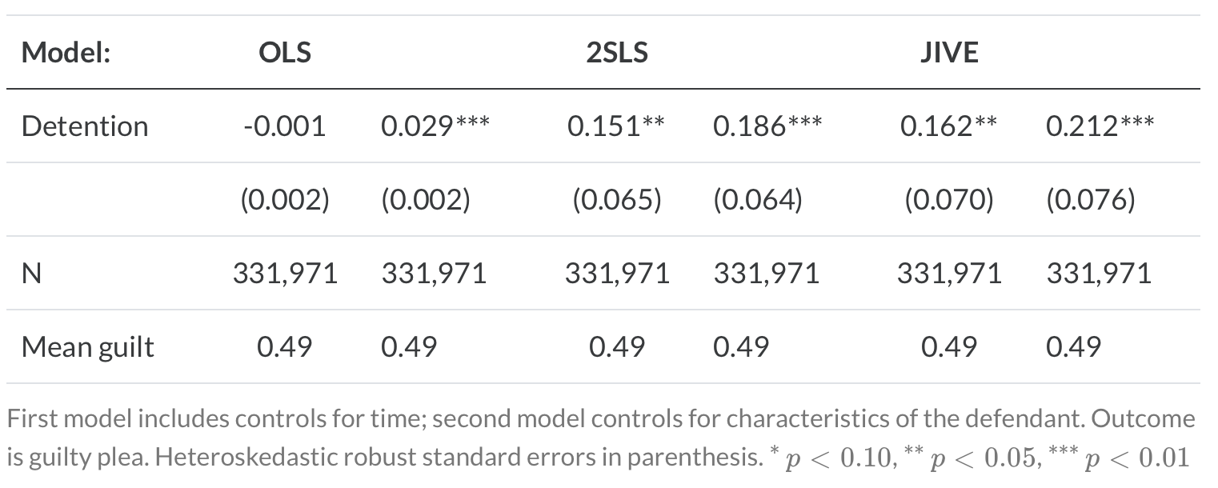
Judge Fixed Effects
Example Results
Under OLS, we find that pre-trail detention is not associated with a guilty pleas
Under IV or JIVE, Stevenson (2018) finds that the likelihood of a guilty plea increases by 15%-21%

